Slide 1
Angular 1.3
From 0 to 100 In 1 Day

Slide 2
Resources To Use
https://code.jquery.com/jquery-1.11.3.min.js
http://maxcdn.bootstrapcdn.com/bootstrap/3.2.0/css/bootstrap.min.css
https://cdnjs.cloudflare.com/ajax/libs/angular.js/1.3.16/angular.js
http://api.openweathermap.org/data/2.5/weather

Slide 3
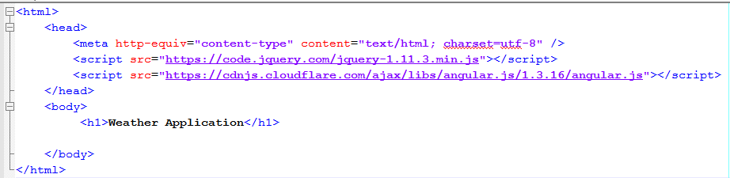
Adding Angular to the page
Create a simple Web Page with HTML, HEAD and BODY elements
Angular depends on jQuery. By default, it includes jQLite. But it is not compatible with IE 8.0. so include the full jQuery (1.X) before Angular.

Slide 4
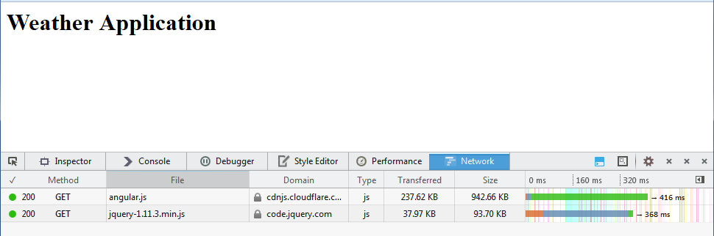
Try Out
Launch the page in Browser and examine you are able to load the Angular and jQuery

Slide 5
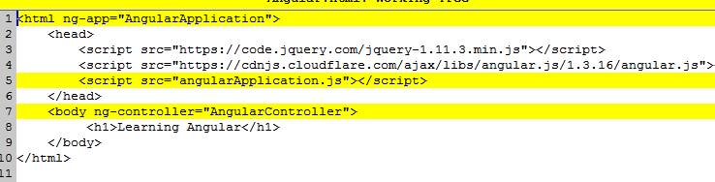
Assign a Module and a Controller
Here is the most basic step to “angularize” a web page
Here we added the attribute “ng-app” to the html
And “ng-controller” to the body tag
We also included a “js” file which will have the application code

Slide 6
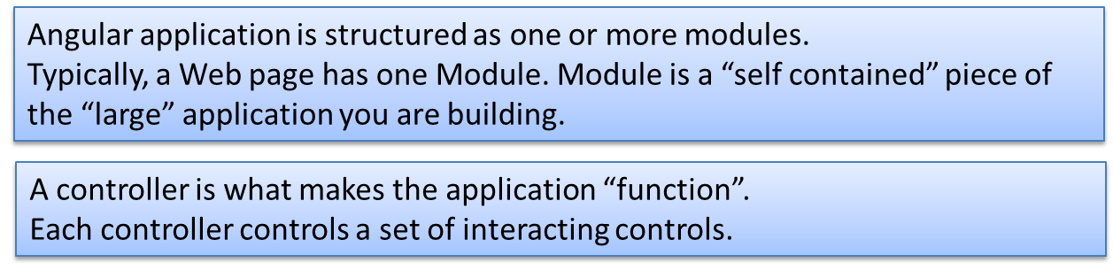
Attributes: ng-app, ng-controller
A module can access other modules
Controllers have scope!

Slide 7
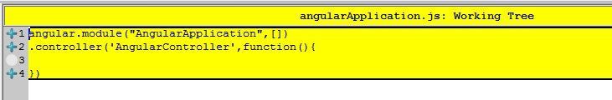
Create the Module and Controller
Create a new JS file and include in the application
angular.module – creates module
.controller – creates a controller
Module is an entire Application or a part of application
Angular creates a default global model for each Module, called $Scope
A controller is an observer and mediator between the View and the Model
Remember: A good Controller will have as little logic in it as possible.

Slide 8
Creating/Accessing Modules
angular.module("AngularApplication", [])
// Creates a new Module
angular.module("AngularApplication", [Module1])
// Creates a new Module with Module1 available for sharing
angular.module("AngularApplication")
// gets the existing module
Module A
Interdependent Modules
Module B
Module C

Slide 9
Scope
Scope is the automatic “Model” initialized for each module
The controllers and modules are “free” to use it as their “private shared store”
Scope is used to “bind” member variables to view elements
Once bound, the variables and elements are watched for changes
The changes are reflected immediately
2-Way data binding – the most important value propositionof Angular

Slide 10
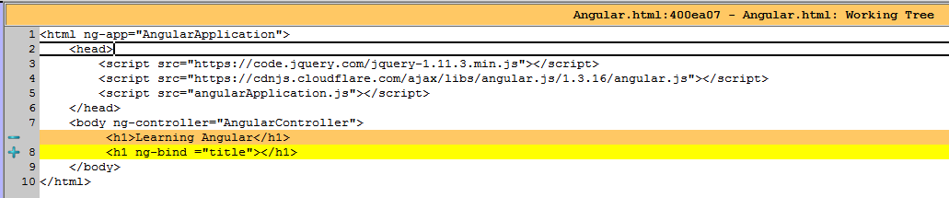
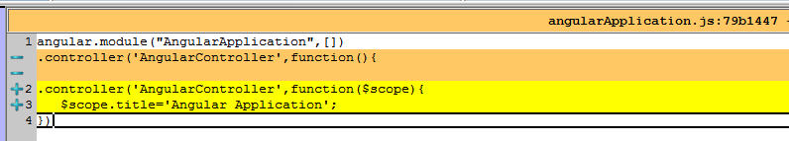
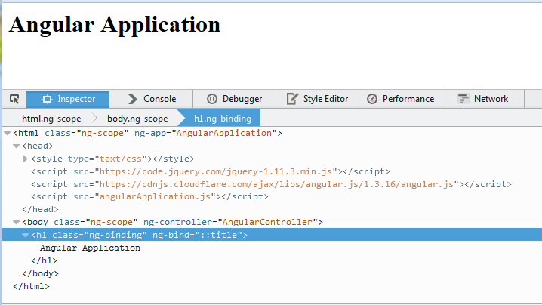
Using Scope to Bind
Declare the bindings in HTML
Access them via scope

Slide 11
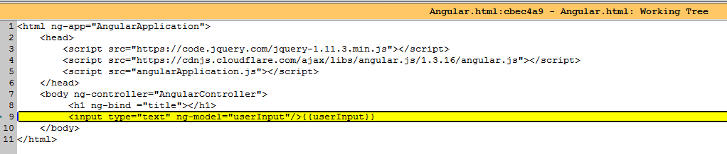
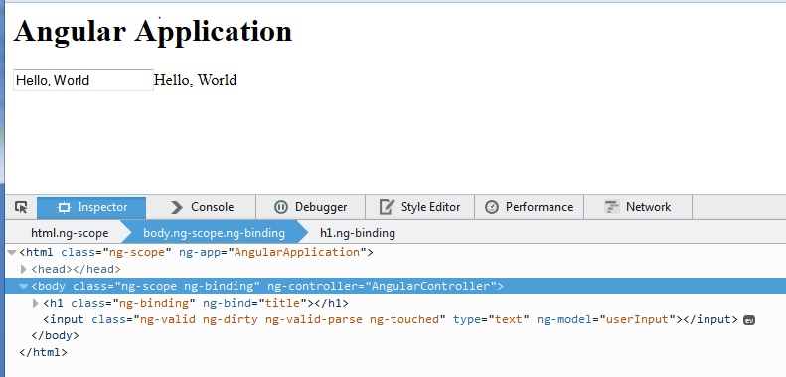
ngModel vs ngBind
Bind is one way
Model is two ways

Slide 12
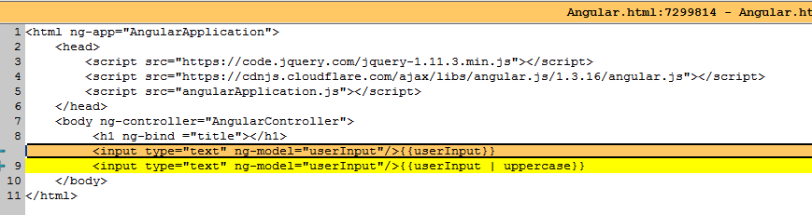
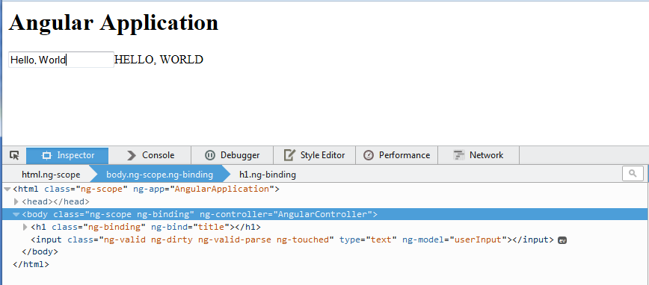
Filters

Slide 13
Now let’s create an Application
Should show a list of cities
Fetch Weather for the selected City from a REST service
Format the Weather Data
Display the Data in Basic mode and Advanced mode

Slide 14
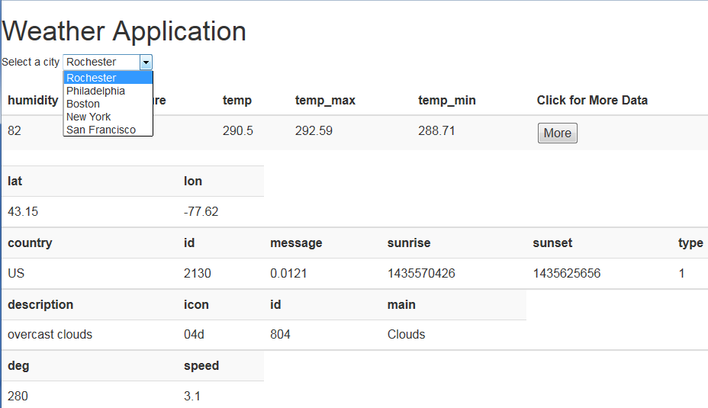
Application UI MocK

Slide 15
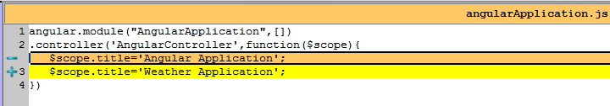
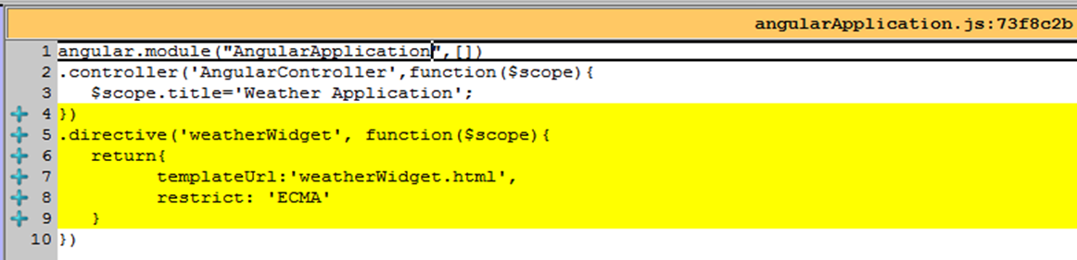
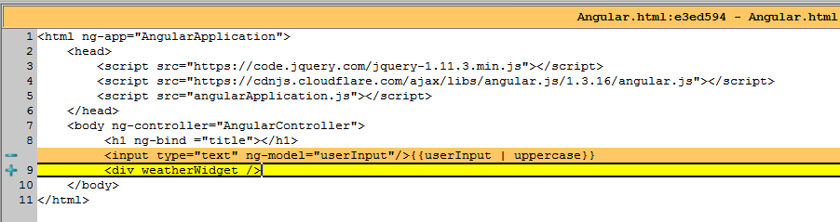
Wrap the feature in a directive
Declarative vs Imperative Discussion
Let’s imagine the entire application is
abstracted to an attributed element

Slide 16
What is a Directive
An Element, Attribute, Comment, or a Class
Used by just declaring
Equivalent to Components
Autonomous
Can refer to other directives
Can share data with others via controller scope
Can have private scope

Slide 17

Create a Directive
Template/template URL: has the rendering Template, may include other directives
watch Recursion
Restrict: by Element, Class, Comment, Attribute or Allow All
Can share or have private scope
<weatherWidget/>
<div class="weatherWidget" />
<!-- directive:weatherWidget -->
<div weatherWidget="" />
Angular has no rendering engine
Only directives should have markup
Use Attribute restriction
Use Private scope

Slide 18
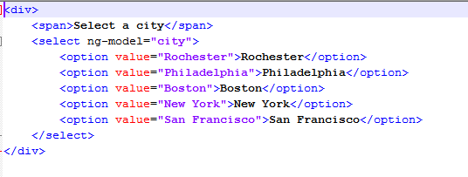
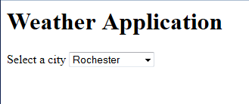
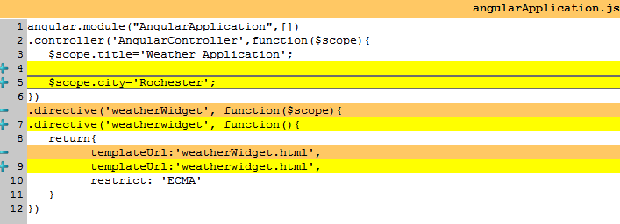
Template of the directive
Create the template in HTML
We have hard coded the markup!
Let’s get the Cities List from the controller.

Slide 19
Built-In Directives
Ng-show – shows when the condition is true
Ng-if – executes when the condition is true
Ng-Hide - !ng-show
Ng-class – adds a class when the condition is true

Slide 20
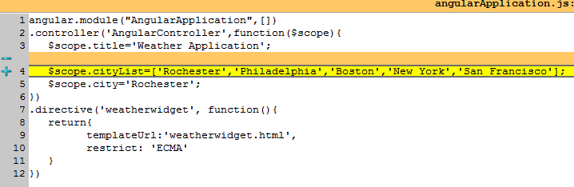
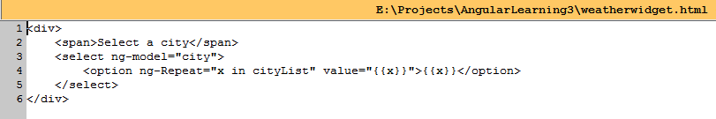
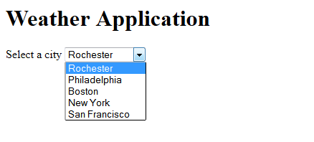
Pass values to the Template from Controller
Controller owns the Data Now,
this is an anti-pattern. So Let’s create a Service.

Slide 21
What is a service?
Acts as an interface
Usually Stateless (unless caching is implemented)
Delegates to a Factory to do the actual Work
Assembles Objects according to Business Rules
A Singleton Reference to the consumers

Slide 22
Angular Architecture
controller
View
Service
Factory
Module
Backend/External

Slide 23
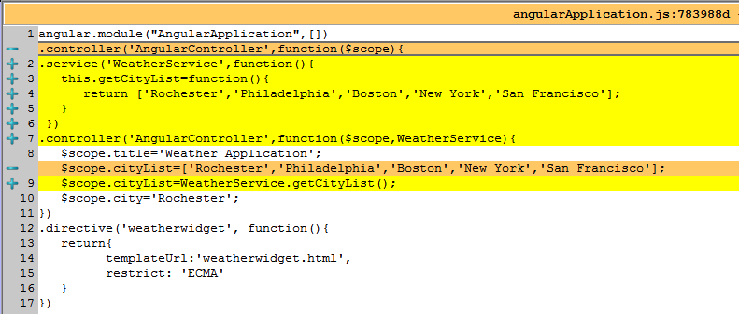
Service
Controller calls Service to get the required data.
Notice how the service instance is passed to the controller
Service does not “return anything”.
It decorates a precreated singleton object.

Slide 24
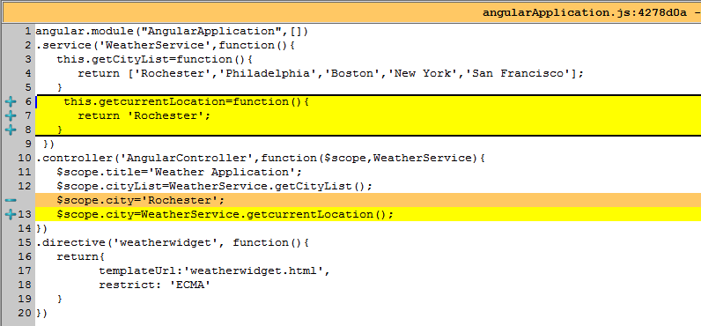
Add another service function

Slide 25
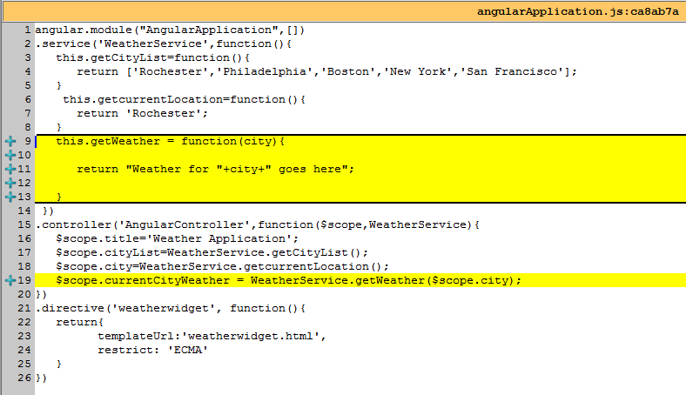
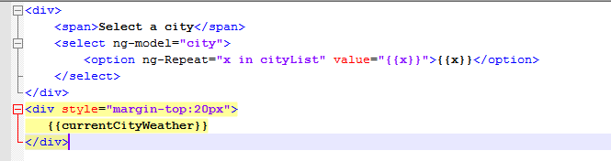
Add a REST function to get Weather
But there is no event handler

Slide 26
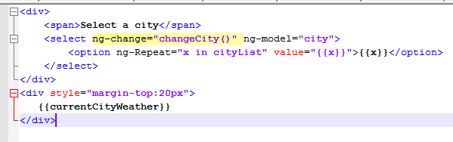
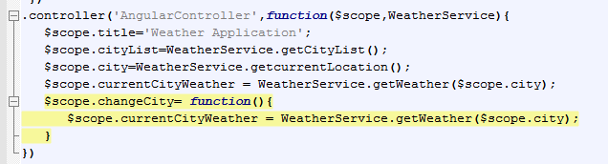
Add Event Handler to the List Box

Slide 27
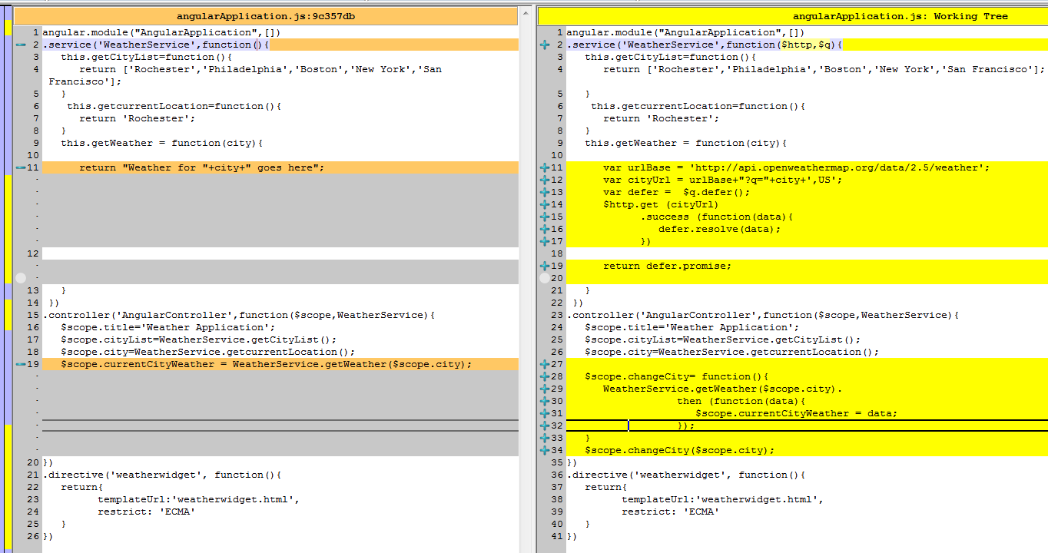
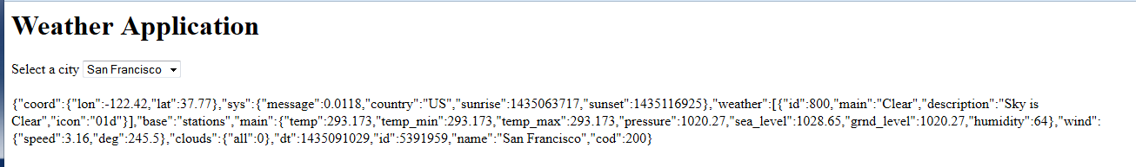
Implement Rest Service

Slide 28
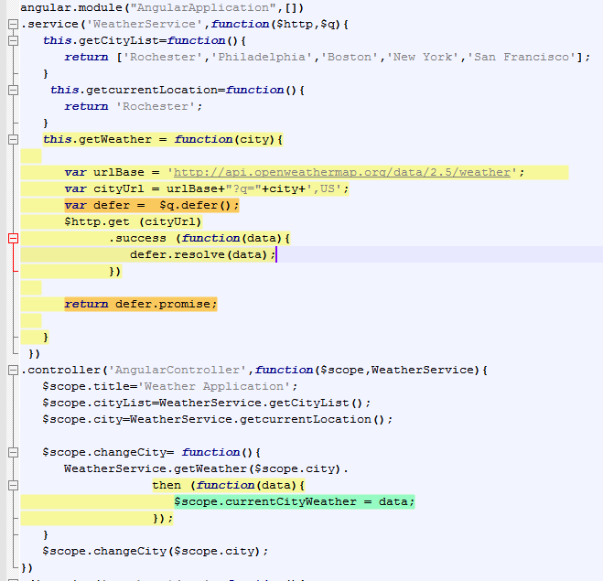
Handling Asynchronous REST

Slide 29
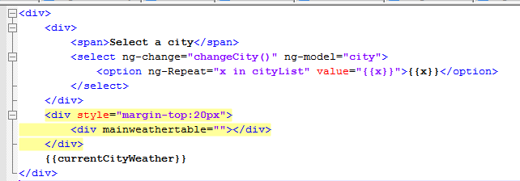
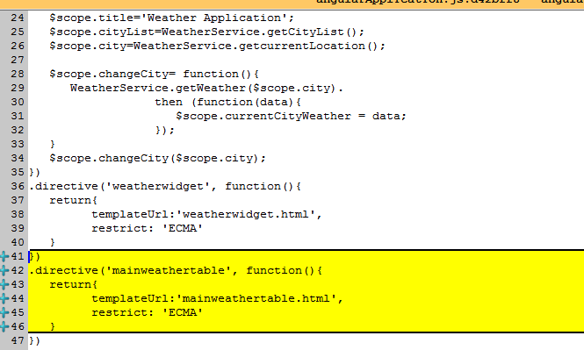
Main Weather Table Directive

Slide 30
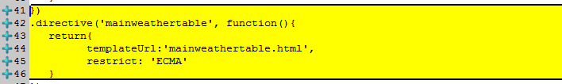
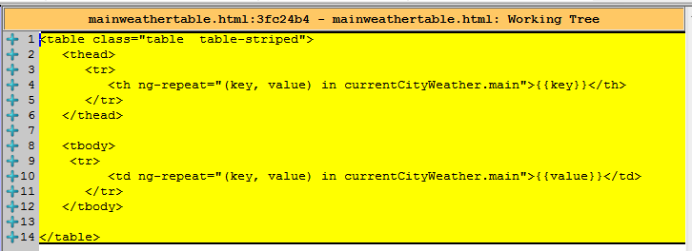
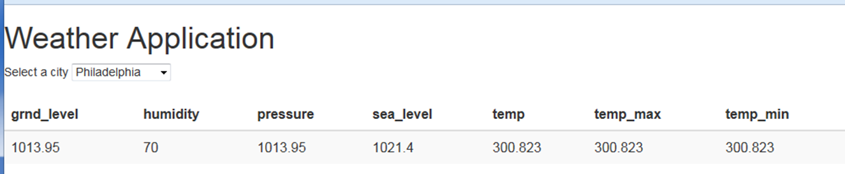
Implement a Table Directive

Slide 31
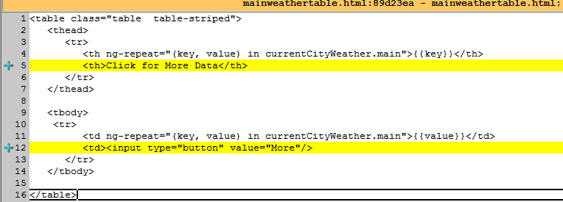
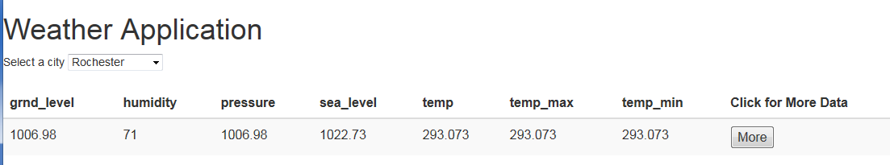
Add an Action to the Table

Slide 32
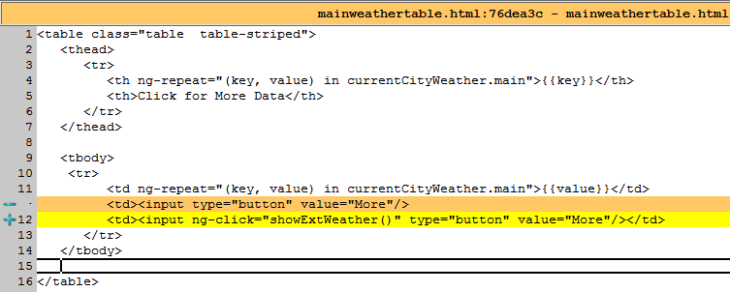
Assign Action handler

Slide 33
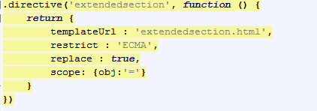
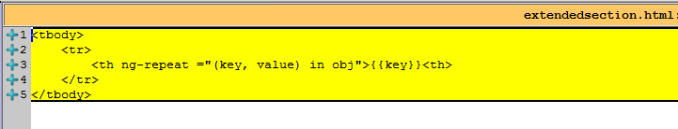
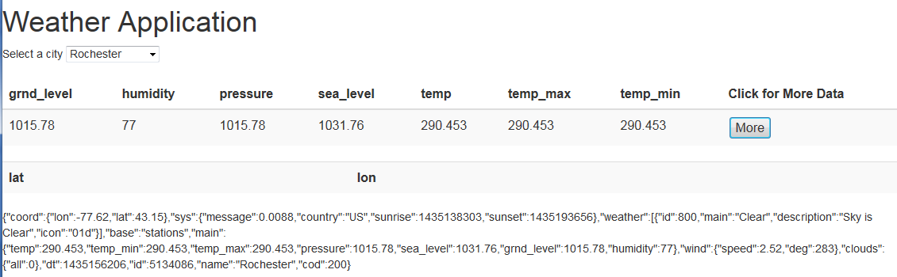
Add a new Directive

Slide 34
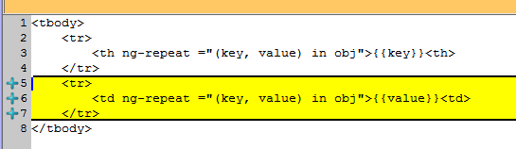
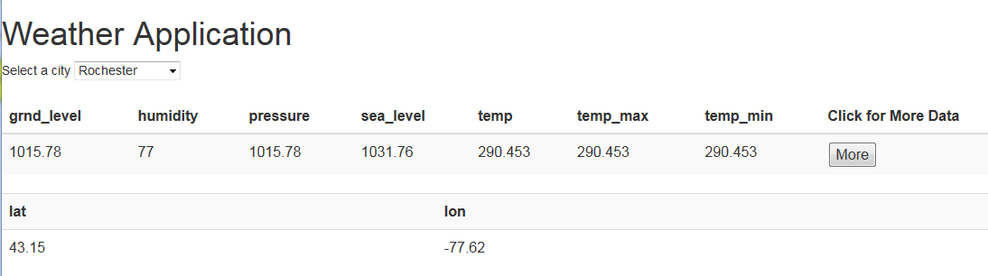
Add more to the directive

Slide 35
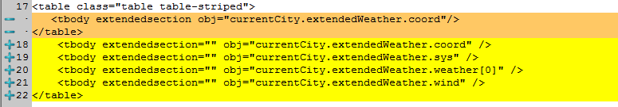
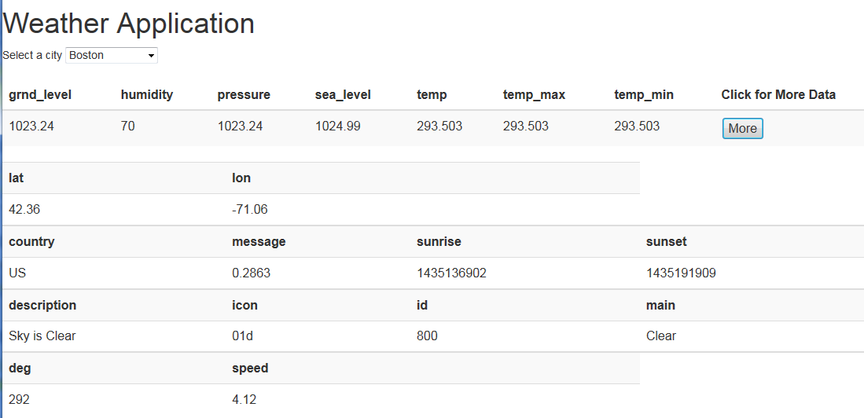

Slide 36
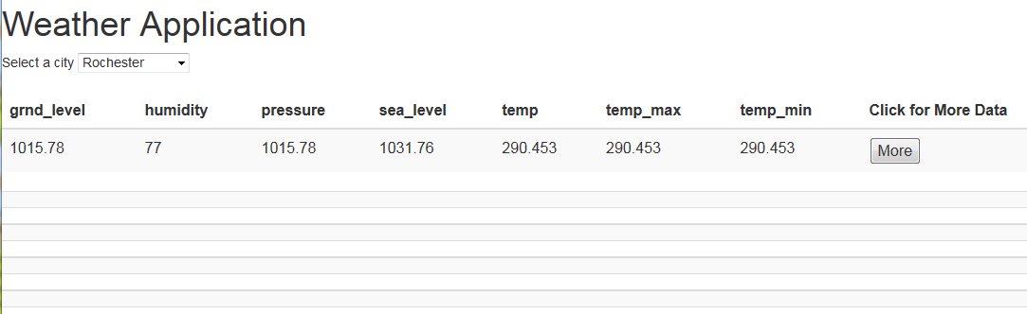
Unwanted Display elements

Slide 37
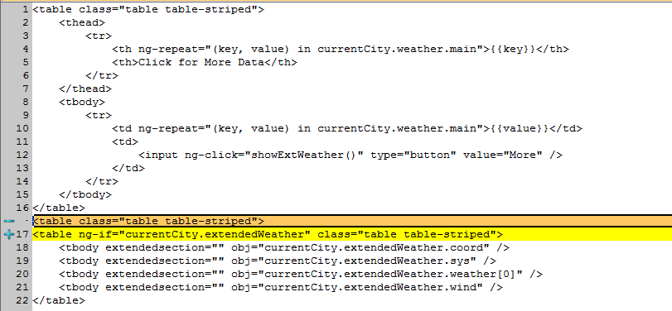
Add ng-if for conditionals

Slide 38
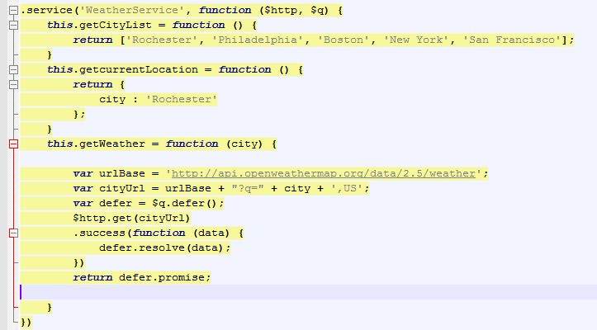
Reexamine Service
Doing actual work
Should act like an interface than a provider
A factory is needed

Slide 39
Factory vs Service
Imagine the “Goods and Services” concept
Factories produce “Goods” or “objects”
Services provide methods to get the Objects
Services should not produce/create objects

Slide 40
Refactor a factory
A factory for each type of “Objects”
Returns an “Object”
Acts like a singleton

Slide 41
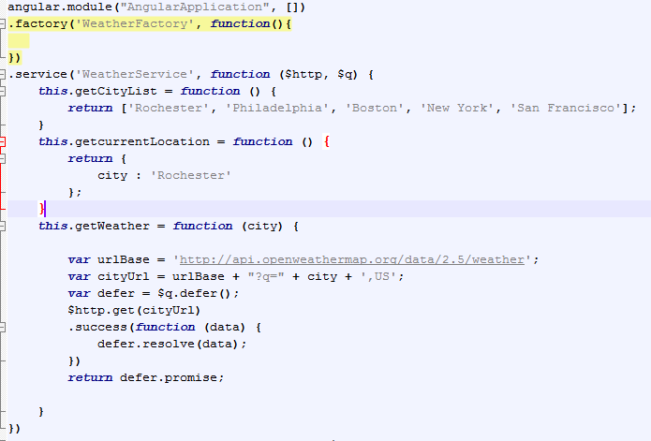
Add a factory

Slide 42

Implement Factory Method

Slide 43

Separate the Communication Layer

Slide 44
Unit Testing
Angular lends itself very well for automated unit testing
Supports Transparent Access of any global object via its formal parameter list
Lend sitself well to BDD testing

Slide 45

Preping the Test Environment
Create a Folder called “lib” and put these files in it
What each of them does, is a bit GOK
Glossary
GOK: God Only Knows

Slide 46

Write a Test Runner

Slide 47

Write the Test

Slide 48

Run the Test
Open test runner in a browser

Slide 49
Exception handling
https://github.com/johnpapa/angular-styleguide#exception-handling
Use a decorator, at config time using the $provide service, on the $exceptionHandler service to perform custom actions when exceptions occur.
Why?: Provides a consistent way to handle uncaught Angular exceptions for development-time or run-time.

Slide 50

Exception handling
Source: http://blogs.msmvps.com/deborahk/exception-handling-in-an-angularjs-application/

Slide 51
Exception Handling
Source: http://blogs.msmvps.com/deborahk/exception-handling-in-an-angularjs-application/
Line 14:
The above code configures the application with a decorator.
The code needs the Angular built-in $provide service, so it is passed as a parameter to the configuration function.
Line 15:
The $provide service is used internally as part of Angular’s component registration process.
The decorator method of this service can intercept requests and provide different or additional functionality.
The decorator method takes two parameters:
The first parameter is the string name of the service being decorated. In this case, it is the $exceptionHandler service.
The second parameter is a min-safe array containing the name of each decorator function parameter and then the decorator function itself.
Line 16:
The decorator function has a dependency on $delegate. So $delegate is listed in the min-safe array.
$delegate provides the original service to the method. This allows you to call the base implementation of that service.
Line 17:
$delegate is passed as a parameter to the decorator function.
Line 18:
This method returns a decorated $exceptionHandler service object.
The returned function has two parameters: the exception and the cause.

Slide 52
Best practices
Modules - Your main application module should be in your root client directory
Reserve $ for Angular properties and services
All DOM manipulation should be done inside directives.
Directives should be kept small and use composition.
Controllers should call Services
Services should use Factories
Services provide Interface methods
Factories create objects
Use Exception Handling
Develop Unit Tests
Test for IE8 first

Slide 53
Please review this
https://github.com/johnpapa/angular-styleguide

Slide 54
IE8 Compatibility
Use Attributed direcytives
Include Jquery 1.X
Polyfill missing javascript functions
Disable Http Caching
Avoid CORS requirements
Adjust the styles for IE8
Test Early
Use Ext-All styles

